Slide 2
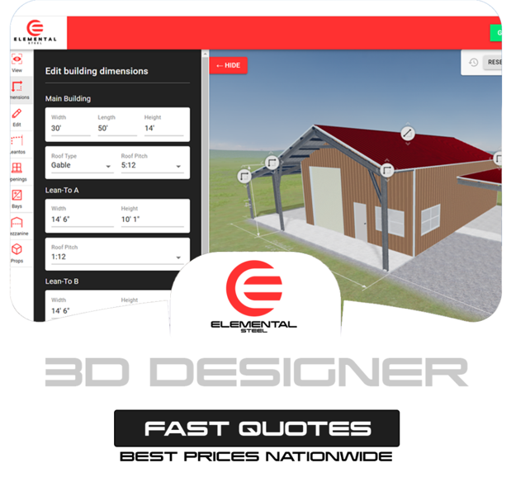
Business Overview
Elemental Steel, established in 2019, emerged in the industry with a commitment to excellence. As a family-owned business. Foundation of Elemental Steel is built on providing top-quality products at the most competitive prices, delivering value that exceeds expectations. Elemental Steel is committed to forging enduring relationships through unmatched service on every project. Our aim is to be a trusted and reliable name in the industry.

Slide 3
SWOT Analysis
Strength
High-quality steel building kits with durable materials.
Customization options to cater to different customers.
Niche expertise in steel structures.
User-friendly website for browsing and ordering.
Weakness
Lack of aggressive marketing strategies compared to competitors.
Struggles to stand out in a competitive steel building industry.
Limited organic traffic and minimal engagement and reach on platforms like Facebook, Instagram, and LinkedIn.
Opportunities
Growth into new markets or industries (e.g., agriculture, storage).
Leveraging SEO, paid ads, and social media to increase brand visibility.
Partnering with contractors and builders for bulk orders.
Threats
Frequent updates in Google and social media algorithms.
Competitors with larger budgets dominate Google Ads and social media.
Difficulty in ranking against well-established brands.
Struggles to convert website visitors due to weak brand presence.

Slide 4
Challenges
Struggles with SEO Rankings : Elemental Steel faced competition against established brands making it difficult to rank for high-competition steel building keywords. Low Organic Traffic : Weak SEO foundations and poor content strategy limited organic visitors and customer reach. Poor Social Media : Despite activity on major platforms, engagement, reach, and follower growth remained low. High Google Ads Costs with Low ROI: Strong competition in the industry led to expensive cost-per-click (CPC) rates in Google Ads which led to high ad costs with minimal ROI. Low Conversion Rates: While the website received visitors, they were not converting due to ineffective targeting and weak call-to-action.
Weak Content Optimization: The website lacked high-quality, keyword-rich content and blogs. Lack of keyword-rich content prevented strong search rankings and customer acquisition. Brand Awareness Challenges: Competing against well-established brands made it hard to build recognition. Lack of SEO Best Practices: Poor website structure and missing on-page elements hurt search visibility. Website Performance & UX Issues: Slow loading speeds and user experience (UX) challenges negatively impacted search rankings, increased bounce rates, and reduced conversions. Competitive Pressure: Major industry players consistently outperformed Elemental Steel across search results, social media platforms, and paid advertising campaigns, making it difficult to stand out in the market.

Slide 5
Solutions Delivered
SEO & Website Optimization Keyword Strategy & Optimization: Targeting high-intent keywords to improve organic rankings. On-Page & Technical SEO : Optimize meta tags, URL structure, and site speed for better search performance. Content Creation: Publish SEO-optimized blog posts, product descriptions, and industry guides. Local SEO : Optimized Google My Business (GMB) and local listings to attract nearby customers.
Social Media Marketing (SMO & SMM) Engaging Social Media Content : Regularly post high-quality visuals, info graphics, and customer testimonials. Community Engagement : Increase interactions through polls, Q&A sessions etc. Paid Social Media Ads: Run targeted ads on Facebook, Instagram, and LinkedIn etc. Influencer & Partnership Marketing : Collaborate with industry influencers to boost credibility and visibility.

Slide 6
Google Ads & PPC Optimization
Optimized Google Ads Campaigns: Improved ad targeting, bidding strategies, and ad copy for higher ROI. Retargeting & Remarketing : Use retargeting ads to bring back potential customers who visited the site. Competitor Analysis for PPC: Identify and counter competitors' ad strategies to maximize ad effectiveness.
Technical Improvements & User Experience Website Speed & Mobile Optimization: Improved loading times and ensure a seamless mobile experience. Landing Page Optimization: Created high-converting pages with clear CTAs and engaging visuals. Competitor Benchmarking: Continuously analyze and refine strategies to stay ahead of competitors.

Slide 7
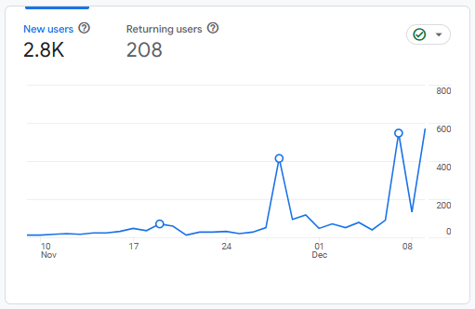
Results - Website Traffic
Increase in New Visitors : Website visitors increased from 200 to 3,000 users, expanding our reach and brand awareness. Growth in Returning Visitors – Improved from just 10 to 200 users, demonstrating better user retention and interest. Boost in Organic Traffic – Traffic from search engines rose from 1,500 to 10,000, meaning better rankings and improved keyword performance. Increase in Direct Traffic : Grew from 50 to 150 users, indicating stronger brand recognition and direct engagement. Rise in Referral Traffic : Climbed from 80 to 200 users, showing improved visibility on external platforms and back links. Higher Local Traffic : Local visitors grew from 200 to 450, confirming improved search rankings and a stronger local presence.

Slide 8
Results - Conversions
The screenshot below showcases the daily conversions achieved through various marketing channels for Elemental Steel. *Key Events = Leads

Slide 9
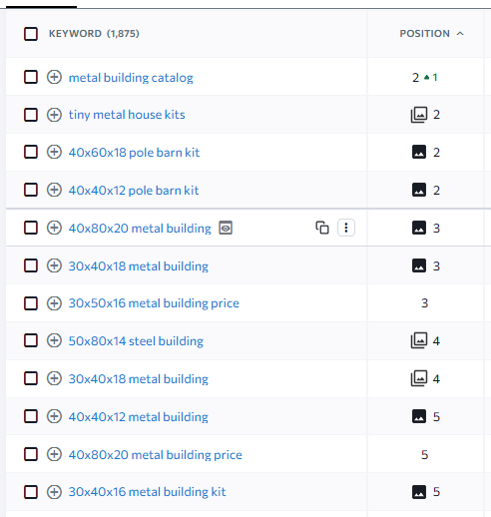
Results - Keyword Ranking
Over 15 keywords are ranking in the top 5 positions on Google.| More than 30 keywords appear on the first page of Google (top 10 results). Over 50 keywords rank in the top 20 search results. A total of 1,500+ keywords are indexed and searchable on Google. Organic search traffic has grown to over 10,000 users per month. Domain authority has increased due to strong back links. Increase in featured snippets and "People Also Ask" rankings for target queries. Click-through rates (CTR) from organic search results have improved. Local SEO rankings have gone up, bringing in more visitors from location-based search.

Slide 10
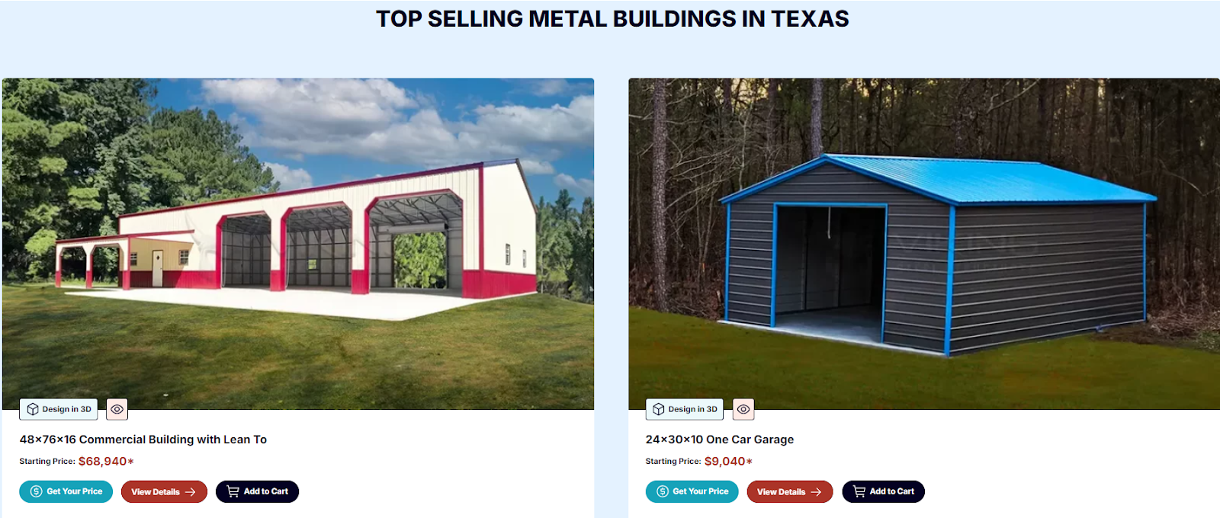
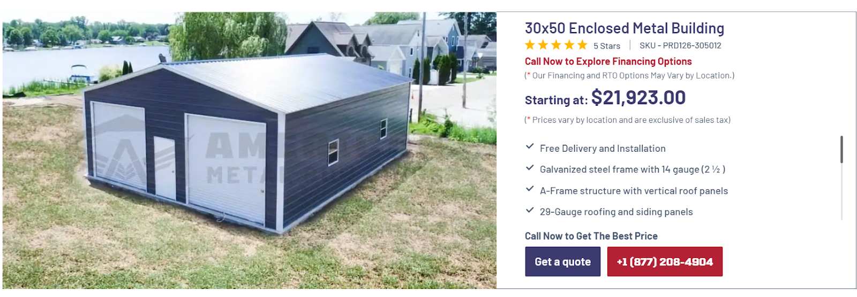
Results – Site Redesign
Header Optimization – Added buttons for checkout, cart, and phone number for better user accessibility.
Footer Enhancement – Included location pages, important legal pages, contact section, and social media icons to improve navigation and credibility.
Location Pages Optimization – Enhanced location pages by adding detailed building information to provide better insights to users.
CTA Optimization – Improved call-to-action elements, including price buttons, inquiry sections, and contact forms, to boost conversions.
Product Page Enhancement – Updated product pages with detailed descriptions and optimized CTA buttons for a better shopping experience.

Slide 11
Results - Google Ads
The screenshot below highlights the monthly performance of Google Ads for Elemental Steel:
250 leads achieved in one month.
Approximately 14K clicks received.
Around 500K impressions recorded.
Strong CTR (Click-Through Rate) for paid campaigns.
Campaigns included Search Ads, Display Ads, and Performance Max campaigns.
.
Clicks: The number of times users clicked on the Google ads.
Impressions: The number of times the Google ads was shown to users
Click-Through Rate (CTR): The percentage of people who saw the ad and clicked on it.

Slide 12
The screenshot below showcases the performance of our ongoing Google Ads campaigns for the Metal Building Business (Elemental Steel):
250+ leads achieved monthly.
Approximately 15,000 clicks generated through Google Ads.
Various ad formats utilized, including Search, Display, Performance Max, and Shopping Ads.
Over 500K impressions recorded, increasing brand visibility.
Consistent optimization efforts improving CTR and reducing cost per conversion.

Slide 13
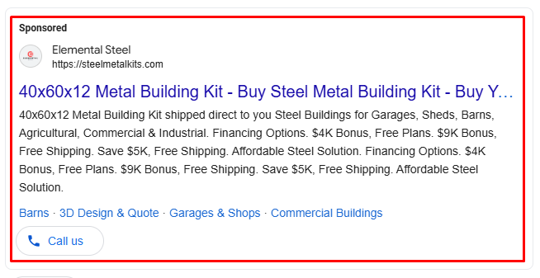
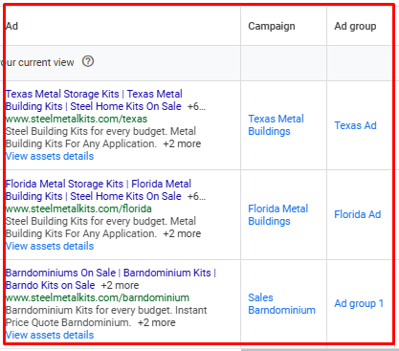
The screenshot highlights the performance of our ongoing Google Ads campaigns for the Metal Building Business (Elemental Steel): All ads are highly relevant with strong Quality Scores. Ads are consistently winning auctions and appearing on the Google search results page. Compelling ad copies with optimized headlines and descriptions to improve engagement. Utilization of ad extensions (site links, callouts, structured snippets) to enhance visibility. Strong impression share indicating a competitive presence in search results. Regular A/B testing of ad copies to improve CTR and conversion rates. Optimized bidding strategies ensuring cost-effective ad placements.

Slide 14
Key Takeaways
The success of our digital marketing strategy for Elemental Steel showcases our ability to drive tangible results through a comprehensive, data-driven approach. By integrating Google Ads, SEO, link building, and content marketing, we have significantly increased conversions, website traffic, and brand visibility.
Google Ads Success – Highly optimized ad copies, strong Quality Scores, and strategic bidding have ensured top placements and a high return on investment.
SEO & Keyword Rankings – We have improved rankings for high-intent keywords, leading to increased organic traffic and brand credibility.
Link Building & Authority Growth – Acquiring high-quality backlinks has strengthened domain authority and search rankings.
Content Optimization – Engaging, SEO-friendly content has enhanced user experience and improved search engine performance.
Our expertise guarantees that we can achieve similar impactful results for your business, helping you grow your online presence, generate more leads, and maximize revenue.

Slide 15
Let’s work together to take your brand to new heights ! Thank You

